Slide 1
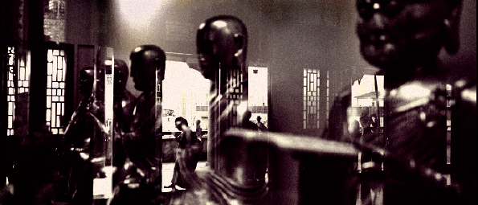
Epistemic vigilance in scientific and religious cognition
Konrad Talmont-Kaminski
UFAM Warsaw, RCC Aarhus i LEVYNA Brno

Slide 2
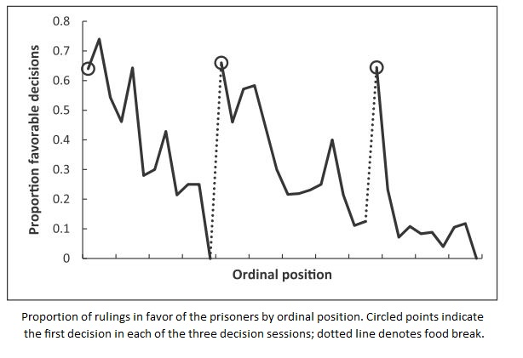

Slide 3
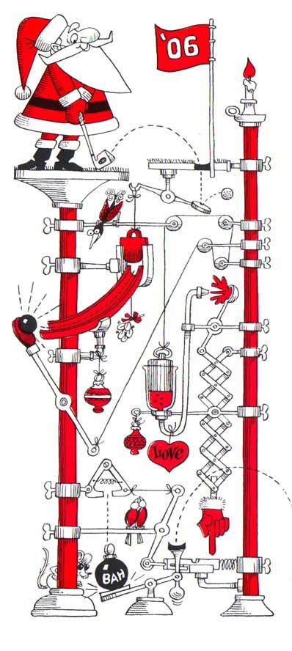
Structure
Cultural Learning
l
Epistemic Vigilance
y
z
Source Vigilance
Content Vigilance
k
k
CRED traditions
Argumentative account
Science
Religions
k
k
Nonalethic function
Truth as norm
q
y
Pragmatic contradiction

Slide 4

Cultural learning
Cultural learning powerful
Allows spread of useful behaviours
Cristine’s work on ritual
Makes possible Machiavellian manipulation
Sperber et al Mind & Language (2010)
Epistemic vigilance required

Slide 5
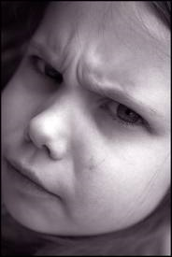
Epistemic Vigilance
Epistemic Vigilance
k
l
Source Vigilance
Content Vigilance
k
l
k
k
Personal interests
Plausibility
General trustworthiness
Logical consistency
Sperber et al
Mind & Language (2010)

Slide 6

Vigilance to content
Argumentative account of reasoning
Mercier & Sperber BBS (2011)
Reasoning not aimed at true belief
A tool of epistemic vigilance
Convincing others
Not being mislead
Cognitive ‘biases’ due to function

Slide 7

Truth as norm
Groups can reason toward truth
Scientific reasoning
Requires appropriate institutions
Truth as explicit norm
Useful where truth tied to function
Division of cognitive labour
De-emphasised source vigilance

Slide 8

Vigilance to source
Credibility enhancing displays
Henrich Evol & Hum Beh (2009)
Machiavellian manipulation easier with language
CREDs costly for manipulators
Mushrooms example

Slide 9
Structure
Cultural Learning
l
Epistemic Vigilance
y
z
Source Vigilance
Content Vigilance
k
k
CRED traditions
Argumentative account
Science
Religions
k
k
Noncognitive function
Truth as norm
q
y
Pragmatic contradiction

Slide 10
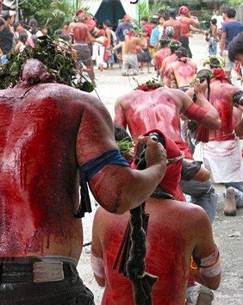
Stabilising religion
CREDs independent of content
CREDs can stabilise costly behaviour
Costly behaviour can be prosocial
Cultural group selection
Religions as CRED traditions
Cognitive byproducts
Dual inheritance account
Content vigilance de-emphasised

Slide 11
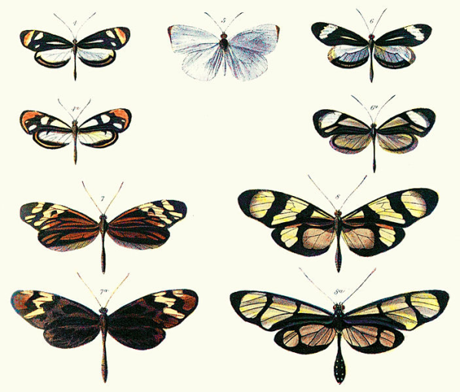
Nonalethic function
NF = not tied to truth
Function of religions nonalethic
Significant consequences
NF ‘parasitic’ upon truth-connected function
Similar to Batesian mimicry
NF requires protection against counterevidence

Slide 12


Truth & function
Correlated
b
*
*
*
*
*
Functionality
*
*
*
*
*
*
*
Accuracy
Uncorrelated
*
*
*
e
*
Functionality
*
*
*
*
*
*
*
*
Accuracy

Slide 13

Superempirical
“Invisible”
“Dangerous”
“Far away”
Superempirical >
Unfalsifiable
Content
Superempirical <
Unfalsifiable
Social
Context
Methodological
Context
Sacred
Available methods
Available tools

Slide 14
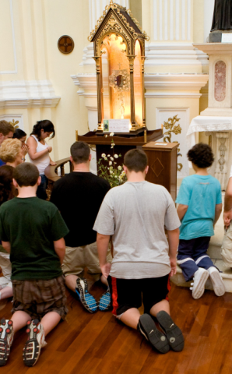
The sacred
Example of social context
Not definitional for religion
Important, none-the-less
A means for maintaining stability
Raise cost of investigating

Slide 15
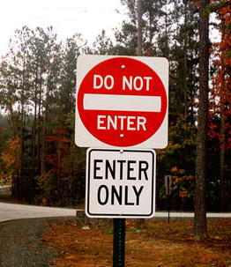
Pragmatic contradiction
Need to protect NF
Conflicts with
Explicit truth norm
Conflict attitudinal not ontological
Both CRED traditions and scientific reasoning potentially functional
No easy solution

Slide 16

Moderating the conflict
Nonoverlapping magisteria (NOMA)
Methodological context?
Science open-ended
NOMA requires withholding of critical faculties
Aspect of social context

Slide 17
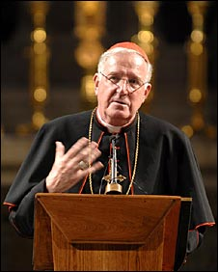
Moderating the conflict
Religious beliefs not about “facts in the world”
Difficult to sustain
Unrepresentative approach
Theological incorrectness
No successful deist religions

Slide 18

Further problem
Not all religious behaviour prosocial
Problematic behaviour
Problematic environments
Need a critical attitude to identify function
Critical attitude undermines function
Reasoning trumps CRED traditions

Slide 19
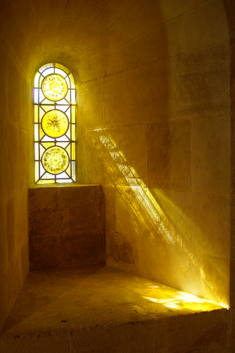
Conclusions
Nonalethic function of religion at bottom of conflict with scientific reasoning
To maintain function religious beliefs must be protected against potential counterevidence
Reasoning trumps CRED traditions

Slide 20
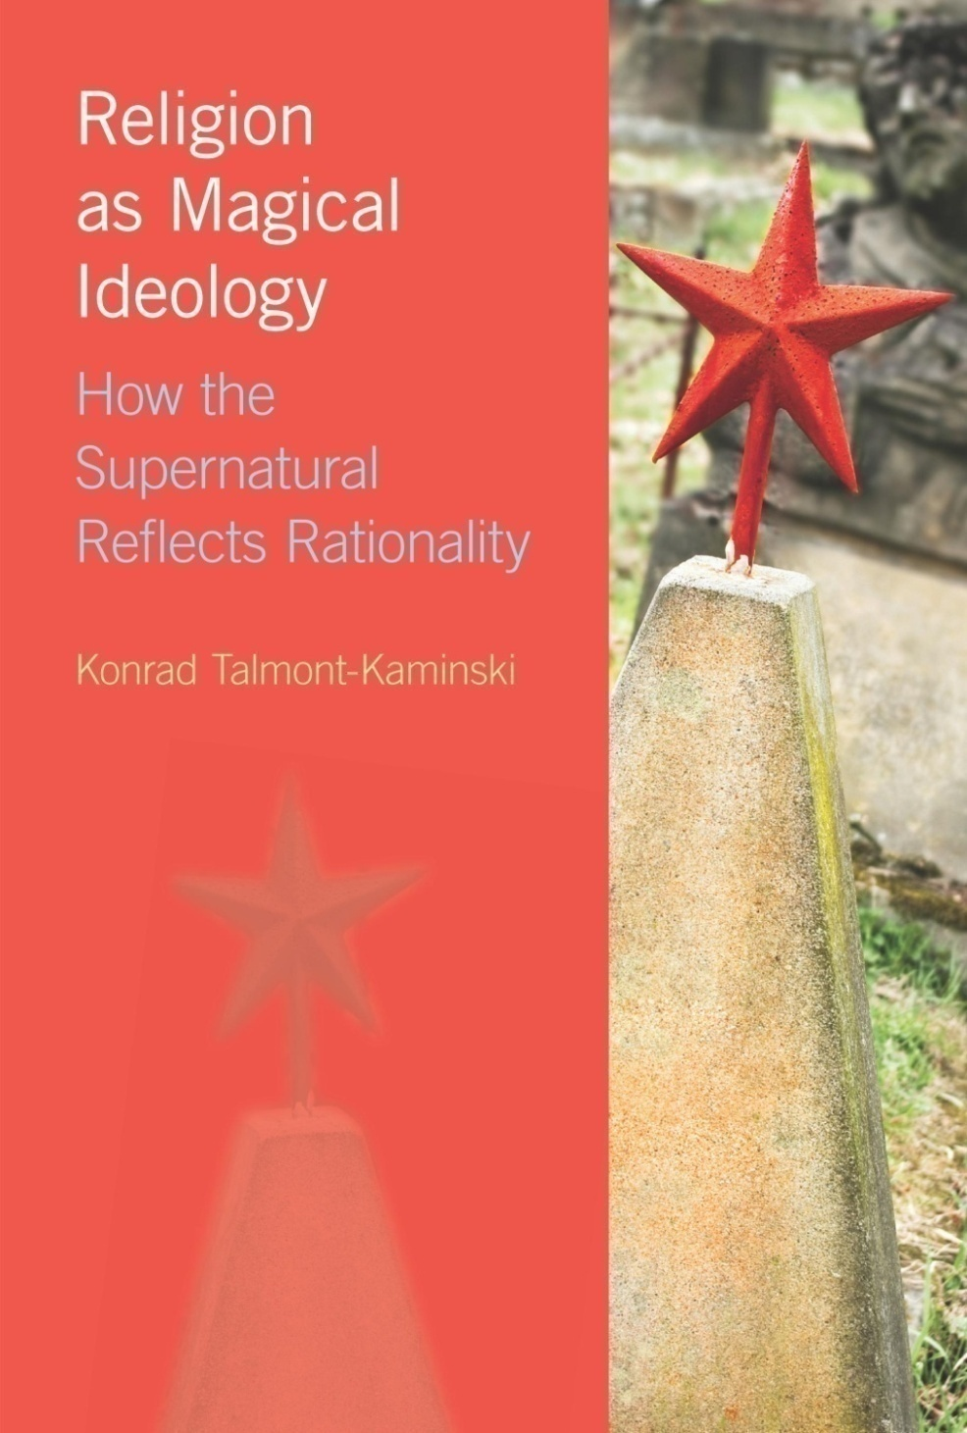
Thank you
Konrad Talmont-Kaminski
Religion as Magical Ideology
“For God and Country, Not Necessarily for Truth” The Monist 96.3 (2013)
konrad@talmont.com
deisidaimon.wordpress.com

